Slide 1
Presentation on Product Review Rating Predication
Author : Chandan Kumar

Slide 2
INTRODUCTION
Research has shown that consumer online product ratings reflect both the customers' experience with the product and the influence of others' ratings.
The opinion information is very useful for users and customers. Businesses can also use the opinion information to design better strategies for production and marketing.
More precisely, 54.7% recognized that these reviews were either fairly, very or absolutely important in their purchase decision making.
Searching and comparing text reviews can be frustrating for users as they feel submerged with information.
The star-rating, i.e., stars from 1 to 5 on online platform, rather than its text content gives a quick overview of the product quality.
The overall star ratings of the product reviews may not capture the exact polarity of the sentiments.

Slide 3
PROBLEM STATEMENT
We have a client who has a website where people write different reviews for technical products. Now they are adding a new feature to their website i.e. The reviewer will have to add stars(rating) as well with the review. The rating is out 5 stars and it only has 5 options available 1 star, 2 stars, 3 stars, 4 stars, 5 stars. Now they want to predict ratings for the reviews which were written in the past and they don’t have rating.
So we, we have to build an application which can predict the rating by seeing the review.

Slide 4
Web Scraping Details
Web Scraping done using selenium web driver.
Data for different product like smartphones, laptops, routers is scraped.
Data scraped from amazon.in & Flipkart.com.
Around 50000 product reviews are scrap for this project.

Slide 5
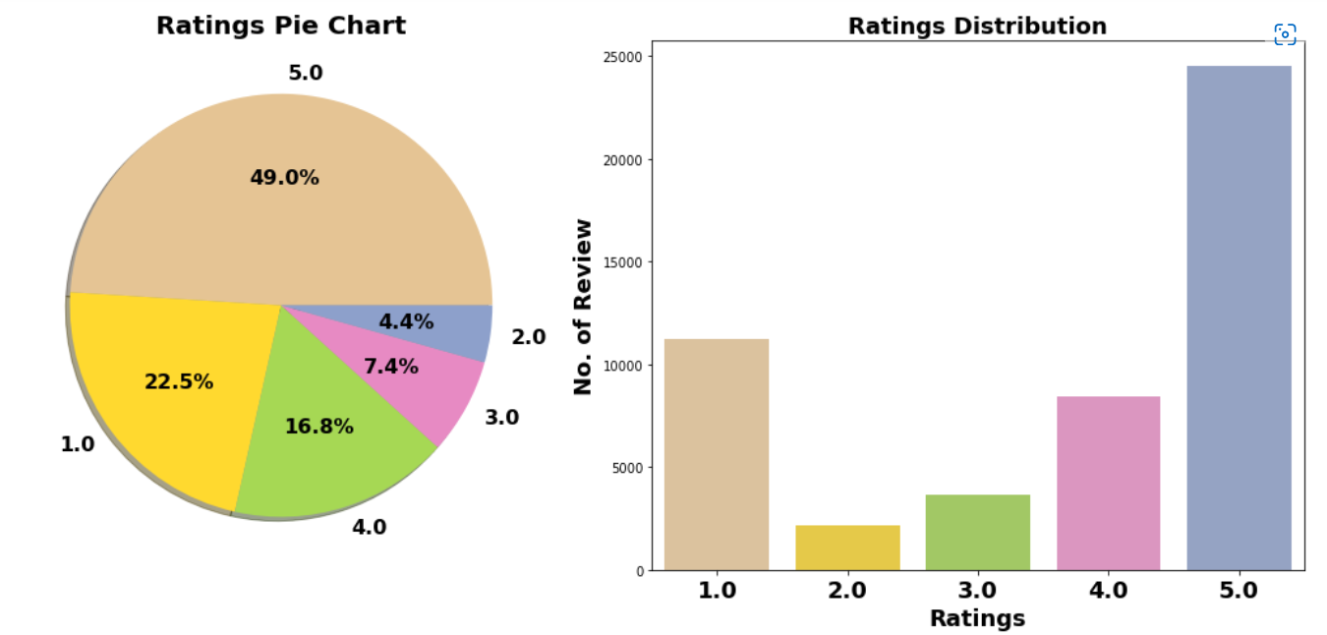
Exploration of Target Variable Ratings
Comment:
1. Around 49% customer given 5- star rating followed by 22.5% customer given lowest 1-star rating.
2. Average Rating is 3.65.

Slide 6
Data Pre Processing
Convert the text to lowercase
Remove the punctuations, digits and special characters
Tokenize the text, filter out the adjectives used in the review and create a new column in data frame
Remove the stop words
Stemming and Lemmatising
Applying Text Vectorization to convert text into numeric

Slide 7
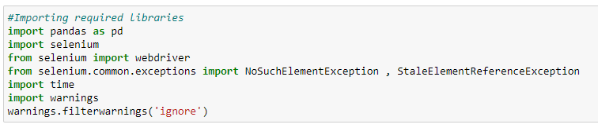
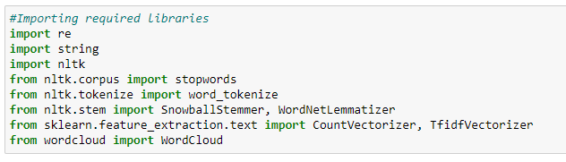
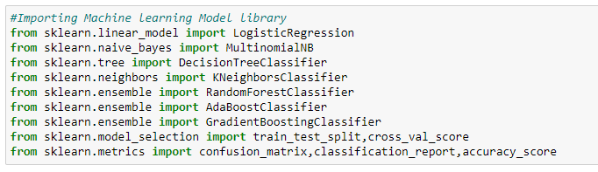
Web Scraping Library used
Text Mining Library used
Machine Learning model building Library used

Slide 8
Machine Learning Model Building
The different classification algorithm used in this project to build ML model are as below:
Random Forest classifier
Decision Tree classifier
Logistics Regression
AdaBoost Classifier
Gradient Boosting Classifier

Slide 9
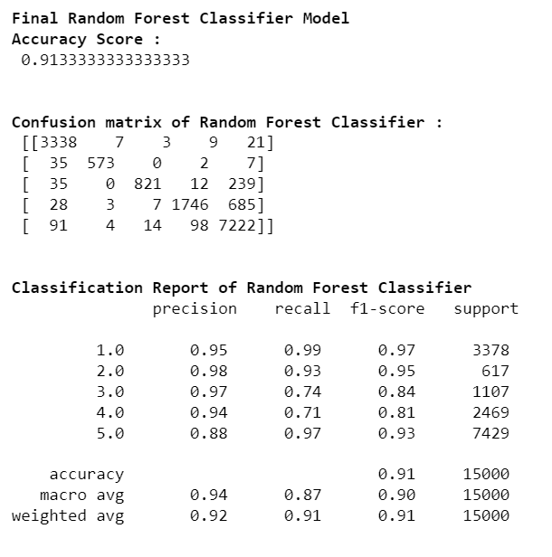
Final ML Model
5-fold Cross validation performed over all model. We can see that Random Forest Classifier gives us good Accuracy and maximum f1 score along with best Cross-validation score. Hyper parameter tuning is applied over Random Forest model and used it as final model.

Slide 10
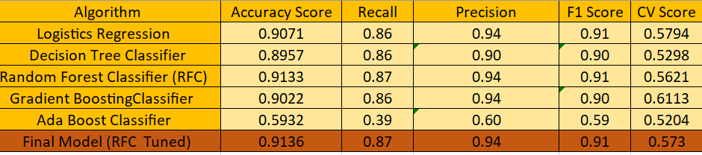
Machine Learning Evaluation Matrix

Slide 11
CONCLUSION
Successfully developed Machine learning model to predict product review ratings.
NLTK library used for text Mining.
Random forest classifier model is best model with accuracy score of 91.36%.

